Slide 1

Clackamas JBO Parent Meeting – February 24, 2026 T-ball/Rookie

Slide 2
Ryan
Our Volunteer CJBO Board Members
CLACKAMAS JBO BOARD CHS Head Coach: JJ Winkle
President: Ryan Joy
Registrar: Banessa Verkest
Area Head: Ike Lackey
Treasurer: Wade Bird
Secretary: Beth Evans
Member at Large: Pat Baker
VP Field & Umpire Liaison: Melissa Pfaff
VP Marketing/Fundraising: Torrey Pietrok
Tournament Director: Jeremy Zimmerman
Field Maintenance: Josh Herlein
Equipment and Uniforms: Nick deFreitas
Rookie Coordinator: Kevin Edge

Slide 3
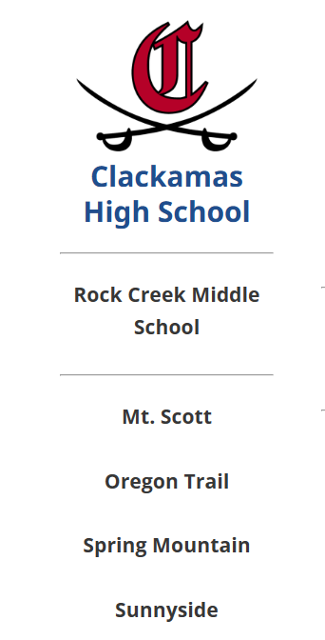
Clackamas Junior Baseball
Ryan
T- Ball through 8th grade follows the JBO guidelines. Each feeder high school program is determined by home address upon registration
NCSD site used to verify address
https://www.nclack.k12.or.us/enrollment/school-boundaries

Slide 4
Ryan
CJBO Mission &
Coaching Philosophy
Mission Statement:
To provide a positive and educational baseball experience
while promoting skill development, sportsmanship, and
having fun.
Coaching Philosophy:
“Relationship First” approach to reach the hearts of our players and
earn their trust. To instill confidence, motivation, and servant
leadership to equip and prepare our players for the next
levels of both baseball and life.

Slide 5
2026 Season CJBO Goals
Ryan
Create the best experience possible for our players
Player and coach safety the number one priority
Continue to improve on Board to Parent accessibility and communication
Continue to support and improve coaching at all levels
Continue to seek ways to upgrade fields
Continue to promote the program
Work closely with the HS coaches to provide coaching clinics and training opportunities
Seek alternative field locations (as our membership grows)

Slide 6
CJBO League Levels of Play
Ryan
T-Ball (Kindergarten through 1st grade) – about 8-10 player teams
Spring Mountain Elementary
Tee and coach-pitch
Rookie (2nd graders and some 1st graders)
Happy Valley MS fields
Player pitch (coach after 4 balls)
Pitching machine
JBO Levels
Minors (3rd/4th) – Home games at Sunnyside/Oregon Trail/ N Clack Park
Juniors (5th/6th) – Home games at HV Park/ N Clack Park
Seniors (7th/8th) – Home games at HV Park/ CHS

Slide 7
Ryan
Equipment and Uniforms
All players will receive a dry-fit Cavs shirt (as part of the registration fee)
All players will receive a Cavs baseball hat
Coaches are provided
Tee for T-ball
Catcher's gear
Practice balls
Game balls
Families are responsible for the following:
Helmet (preferably Cavs colors: black, red, white)
Bat
Glove
Baseball pants (check with your coach, most likely gray)
Cleats
Cups for boys
Optional: baseball belt
Optional: baseball bag
We have donated items in good condition!
Check social media or email clackamasjuniorbaseball@gmail.com

Slide 8
Ryan
Schedule
Practices start after Spring Break (week of March 30th)
Games start the week of April 20th
Season ends the week of June 6th
T-ball
Four teams registered
Twice a week, M-Th, maybe Fridays
Practice and games will be at Spring Mountain Elementary
Game rotation with Cavs and Nelson teams
COACHES NEEDED!
EMAIL CLACKAMASJUNIORBASEBALL@GMAIL.COM
Rookie
Two maybe three teams registered
Games are twice a week, M-Th, maybe Fridays
Please note, depending on game rotation there may be 3 days a week
Kid Pitch and machine pitch games – rotation will vary on number of teams and schedule.
Maybe more of one than the other
Coach may opt for a Saturday practice
Game rotation with Cavs and Nelson teams
Practice and games will be at Happy Valley Middle School

Slide 9
Assessments for Rookie Level
Ryan
Spectators, please stay in your vehicle or at the bleachers
Sunday, March 1st
Last name A-M – 10am
Last name N-Z – 11am
Check in by the Big House hitting facility
Players are required to attend assessments
It gives prospective coaches the opportunity to assess players themselves for a more efficient and fair draft process
Conflicts will be treated on a case-by-case basis
This is a practice opportunity to get ready for minors
Assessment based on:
Playing catch
Infield/outfield work
Hitting
Pitching as necessary

Slide 10
WHERE YOUR REGISTRATION FEES GO
Nick
Major Budgeted Expenses for 2026:
Uniforms and hats
Equipment and field maintenance
Umpires, league fees, and insurance
Operating and administrative expenses
Total annual operating budget: ~$50,000–$55,000
2025 Budget
Fundraising | 28,703.66
Registration | 96,530.24
Total Income | 125,233.90
Field Use & Maintenance | 28,810.97
Umpire Expense | 21,706.00
Hats Uniforms & Equipment | 23,311.52
*Misc. Expenses | 46,314.91
Total expenses | 120,143.40
*Misc Expenses: County fees, insurance, operating expenses, legal & professional fees, etc.

Slide 11
FUNDRAISING SUPPORT EVERY PLAYER
Torrey
Fred Meyer Community Rewards
Multiple options including product sales and donations
New this year: Bottle Drop Can Returns (blue bags)
Restaurant nights and community partnerships
New this year: Pancake Breakfast (details coming soon)
CJBO will host 3 tournaments this season
Business sponsorship opportunities available

Slide 12

Clackamas High School Baseball Partnership
Ryan
Relationship between HS program and CJBO
Big House allocation for upper divisions
Assessments for upper divisions tryouts (impartial evaluators)
Senior level use of HS field/tournaments
Coaches training (clinics)
Youth camps/clinics
Here’s what is happening now!
Zoo Crew Camp on Wednesdays for 3rd-6th grade
Cavs Academy on Thursdays and Sundays for 7th-8th grade

Slide 13
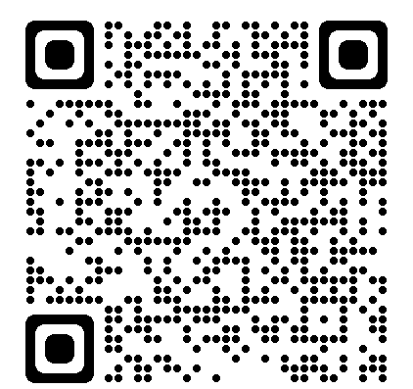
HOW PARENTS CAN HELP
Ryan
Volunteer as coaches, team parents, or field helpers
Assist with fundraising and tournament support
Provide feedback to help us improve the program
Support a positive environment for all players
Help support field maintenance
TAKE AWAYS
CJBO prioritizes player development, safety, and enjoyment
Assessments ensure fair, balanced teams at every level
Registration fees support uniforms, field use, umpires, and insurance
Fundraising and volunteers keep the program affordable
CJBO is strongest when families are involved and supportive
Email: clackamasjuniorbaseball@gmail.com

Slide 14
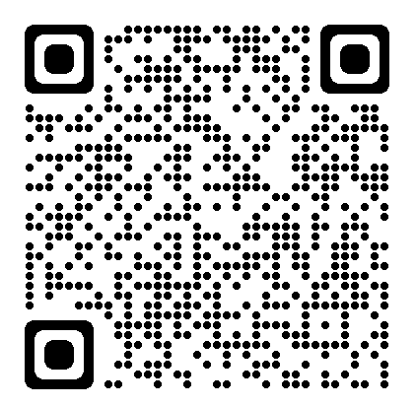
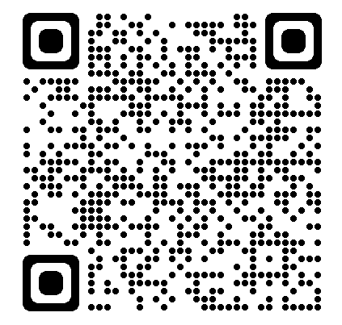
Follow us on Facebook
(2) Facebook
Instagram
Instagram
Clackamas Junior Baseball

